Slide 1
IAM Basics
What is Identity and Access Management?

Slide 2
What is IAM?
Identity and Access Management
– aka IDM, IdM or Identity Management
Purpose of IAM
Ensure correct user(person) have access to the appropriate IT resources
Approach
Establish and maintain one “identity” per person
Central management user accounts
With support for Delegated and Self-Service functions
Provision and reconcile accounts
Notes:
Presenter
2014-10-13 09:52:37
--------------------------------------------
Has several names
Provide unified view of users and their access

Slide 3
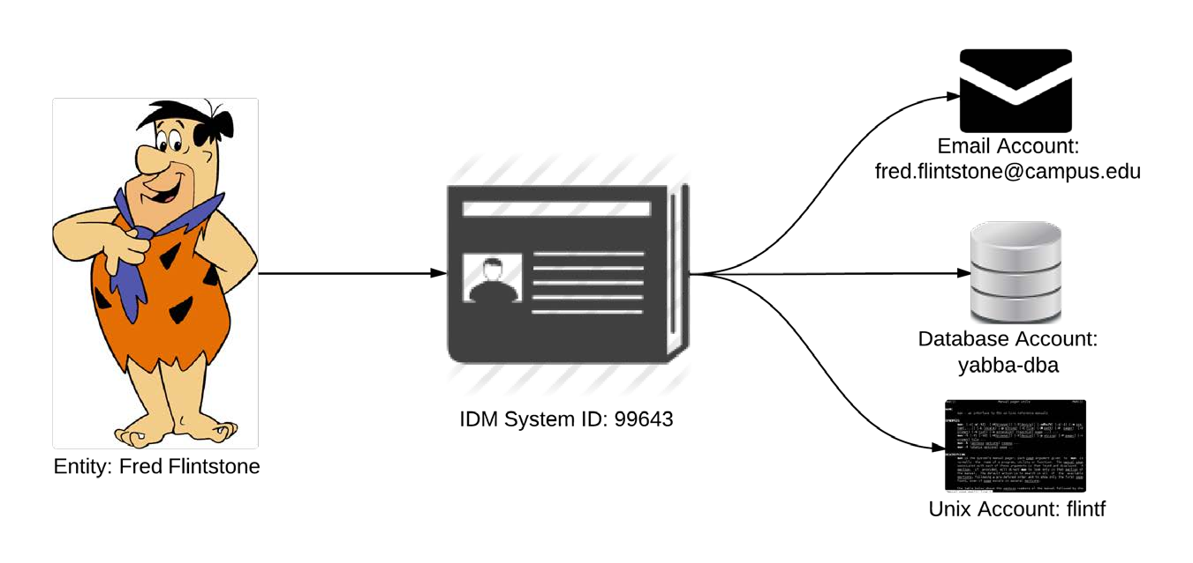
From Identity to Accounts
Notes:
Presenter
2014-10-13 09:52:38
--------------------------------------------
Not all Identities represent actual people. There’s one Fred.

Slide 4
What is IAM?
Mixture of Technology and Process
Business Processes
Common business definitions
Service eligibility
Onboarding processes
Common Technologies
Database, LDAP, AD, Kerberos, Grouper
CAS, WebAuth, Shibboleth/SAML
Notes:
Presenter
2014-10-13 09:52:39
--------------------------------------------
Process Examples:
What defines a ‘current employee’ or ‘current student’?
Do separated employees/graduated students maintain their accounts? What users are granted email accounts?
How are accounts generated?

Slide 5
Elements of IAM
Data Collection
Onboarding, ideally via Systems of Record (SoR)
“The Merge”
Account Management
Administrator Account Controls
Self-Service Functions (Change/Reset Pwd, Data Updates)
Auditing
Central logs tracking account activity/access

Slide 6
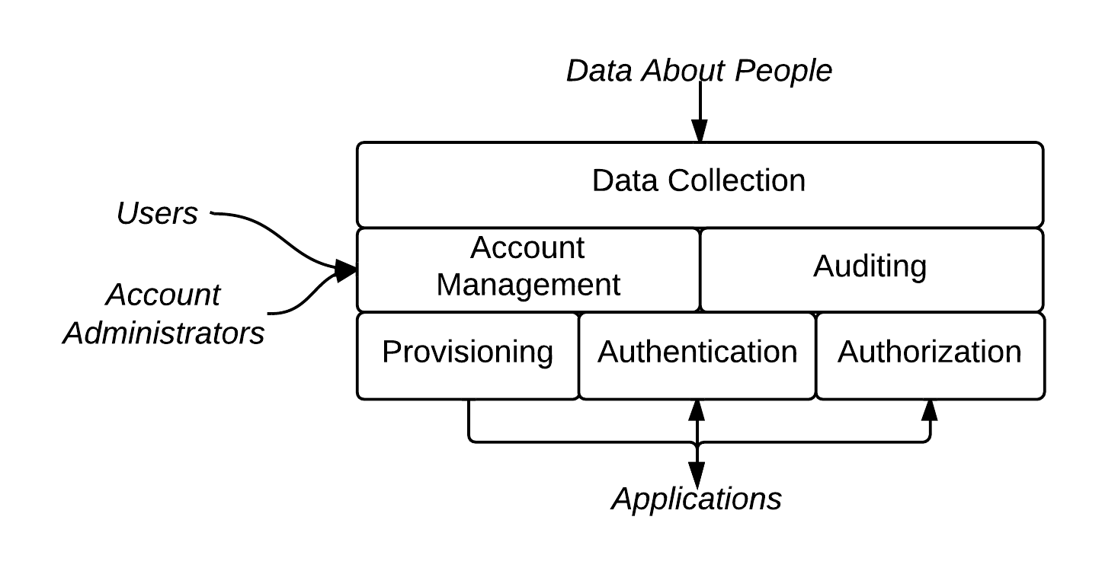
Elements of IAM
Notes:
Presenter
2014-10-13 09:52:39
--------------------------------------------
There are other ways that people define the elements of IAM. “AAA (Authentication, Authorization and Auditing)”

Slide 7
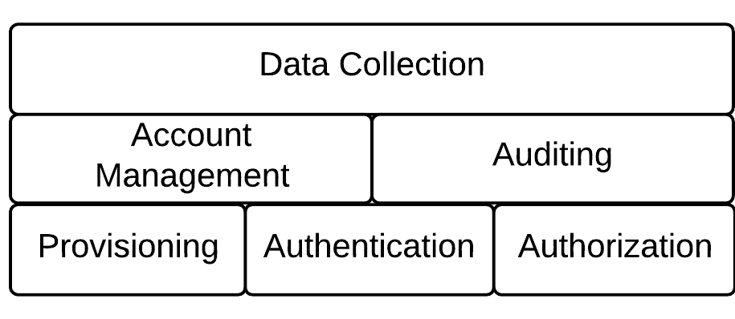
FEDERATED AUTHENTICATION

Slide 8
Elements of IAM
Provisioning
Managing and reconciling accounts in external systems
Authentication
Verifying who you are (aka “login”)
Authorization
Privilege/permission management

Slide 9
Authentication Approaches
Local Authentication
Pass-thru Authentication
Federated Authentication

Slide 10
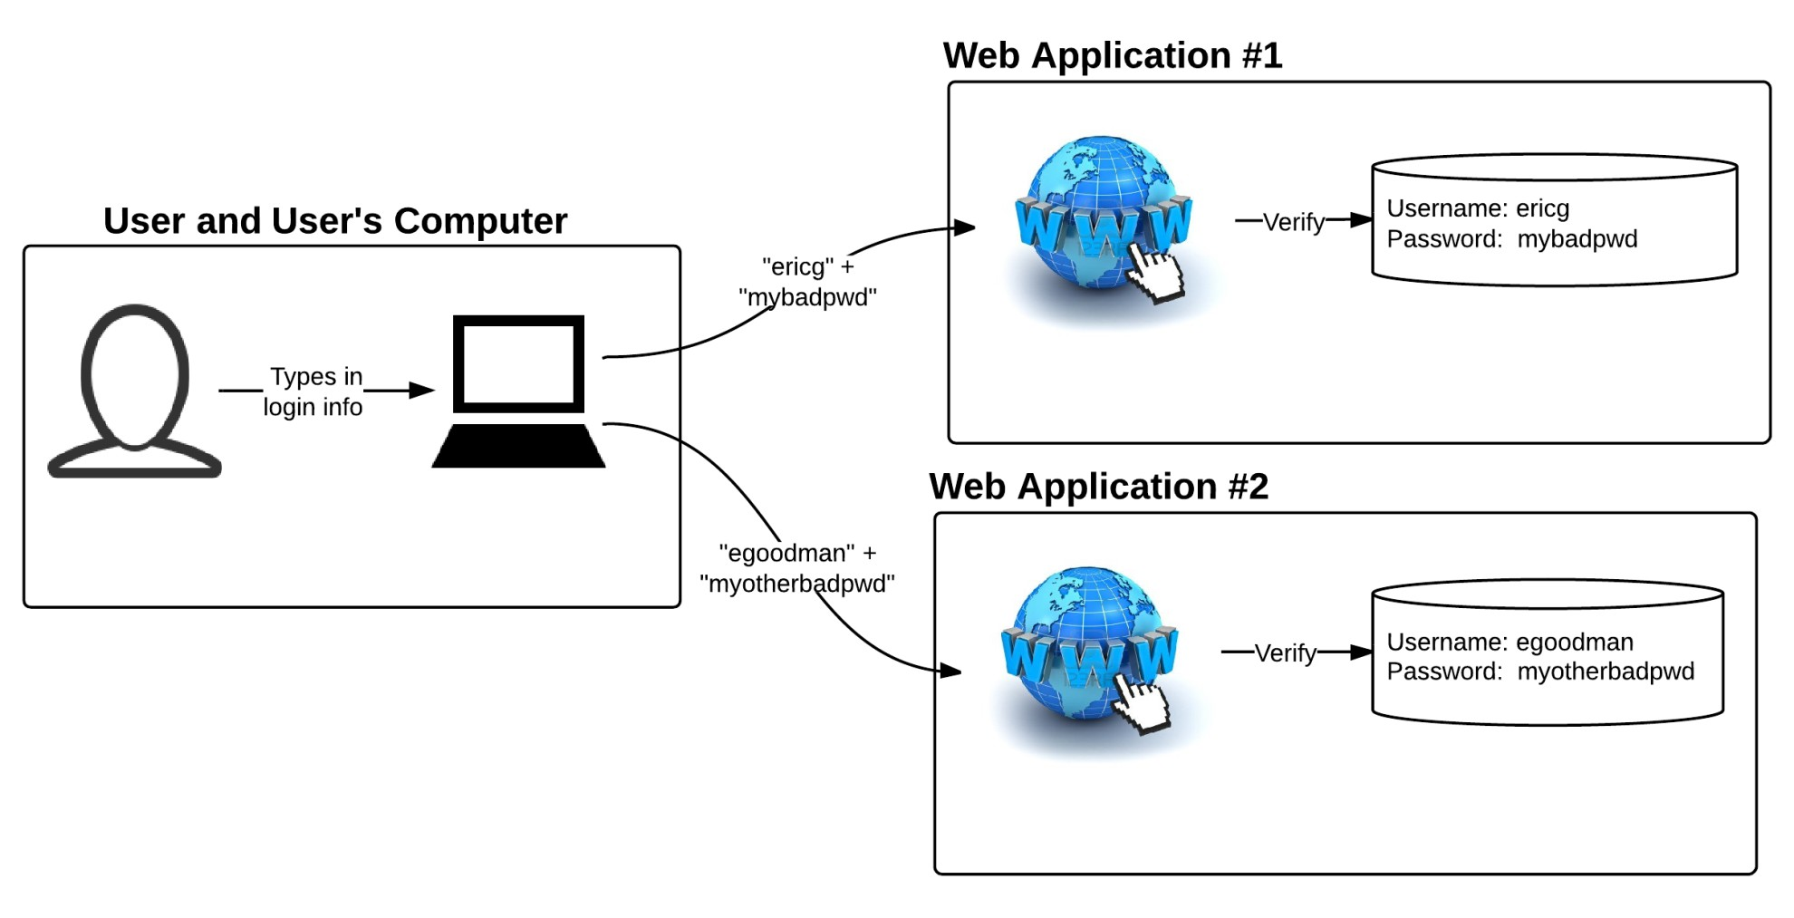
Local Authentication
Notes:
Presenter
2014-10-13 09:52:40
--------------------------------------------
Password management issues

Slide 11
Local Authentication - Scaling
Pros
Flexibility
Different usernames and passwords for each site
No need to integrate with anything else
Cons
Usability
Different usernames and passwords for each site
Doesn’t integrate with anything else
Security
Risk that users will reuse passwords (can’t be audited)
Passwords are used everywhere

Slide 12
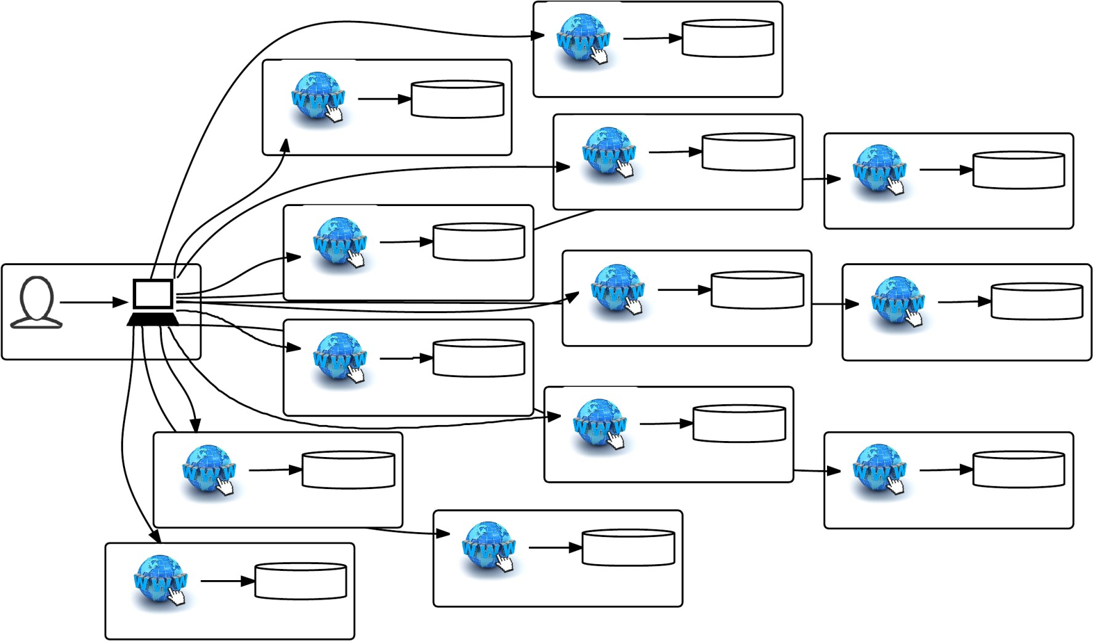
Local Authentication - Scaling

Slide 13
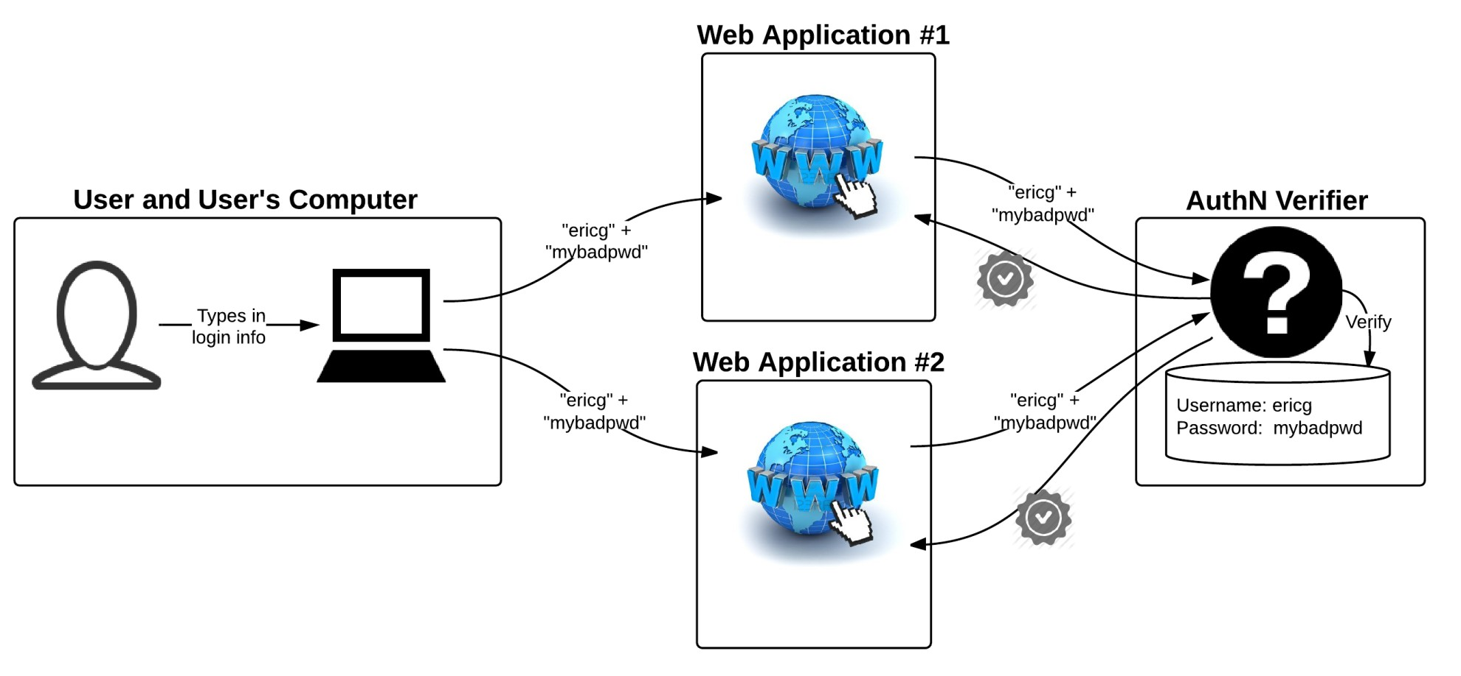
Pass-thru Authentication
“Borrowing your credentials”
Notes:
Presenter
2014-10-13 09:52:41
--------------------------------------------
Replicon, ServiceNow, SharePoint

Slide 14
Pass-thru Authentication - Scaling
Pros
Consistency
Same username password at each site
Single database for account/password changes
Cons
Security
May have to grant external applications access to internal systems
Many sites handle user passwords
Trains users to enter passwords on any web site
User has no way to validate website
Authentication service can’t distinguish you from the application
Application is “pretending to be you”
Audit, access issues

Slide 15
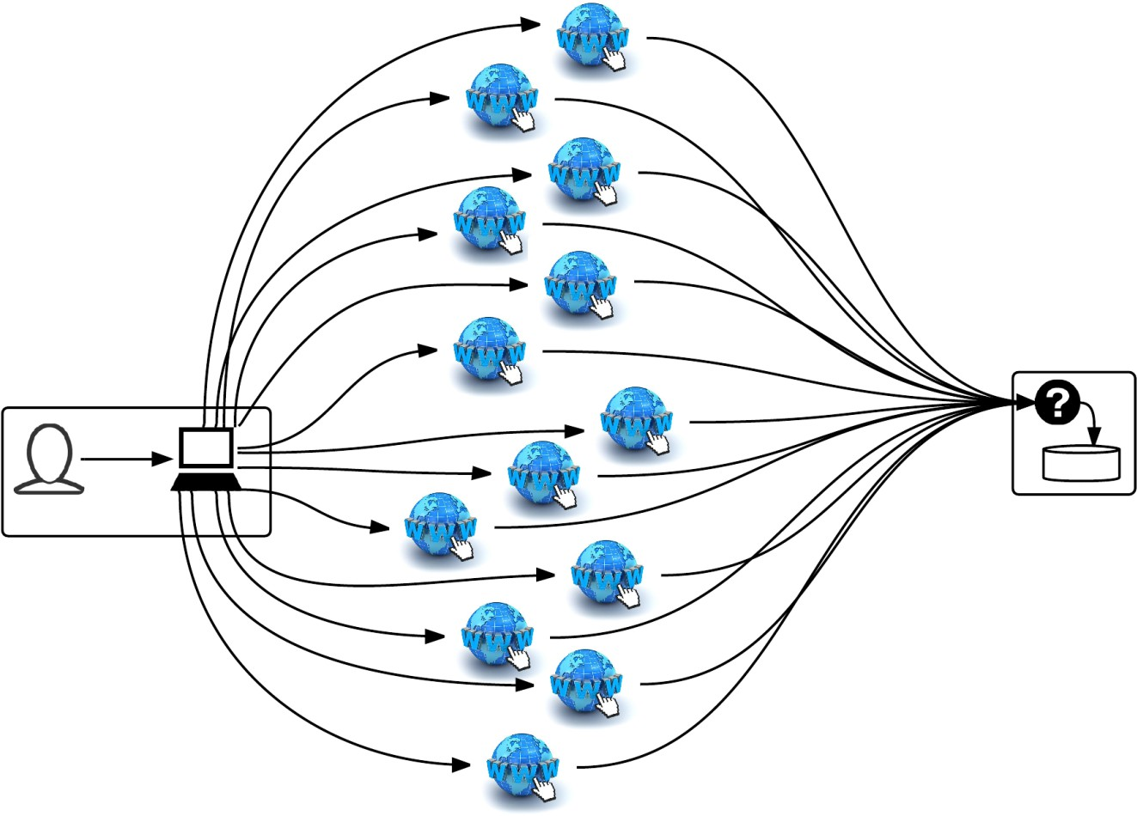
Pass-thru Authentication - Scaling
Passwords everywhere!

Slide 16
Federated AuthN
Authentication as a service
What is Federated Authentication?
Isolates authentication into a separate service
Use your “home” account to access “remote” systems
Federation Basics
Security Assertion Markup Language (SAML)
Shibboleth
Other protocols and programs exist
Examples
TRS, Connexxus, LMS
Notes:
Presenter
2014-10-13 09:52:41
--------------------------------------------
If you’ve used example apps, you’ve seen federation

Slide 17
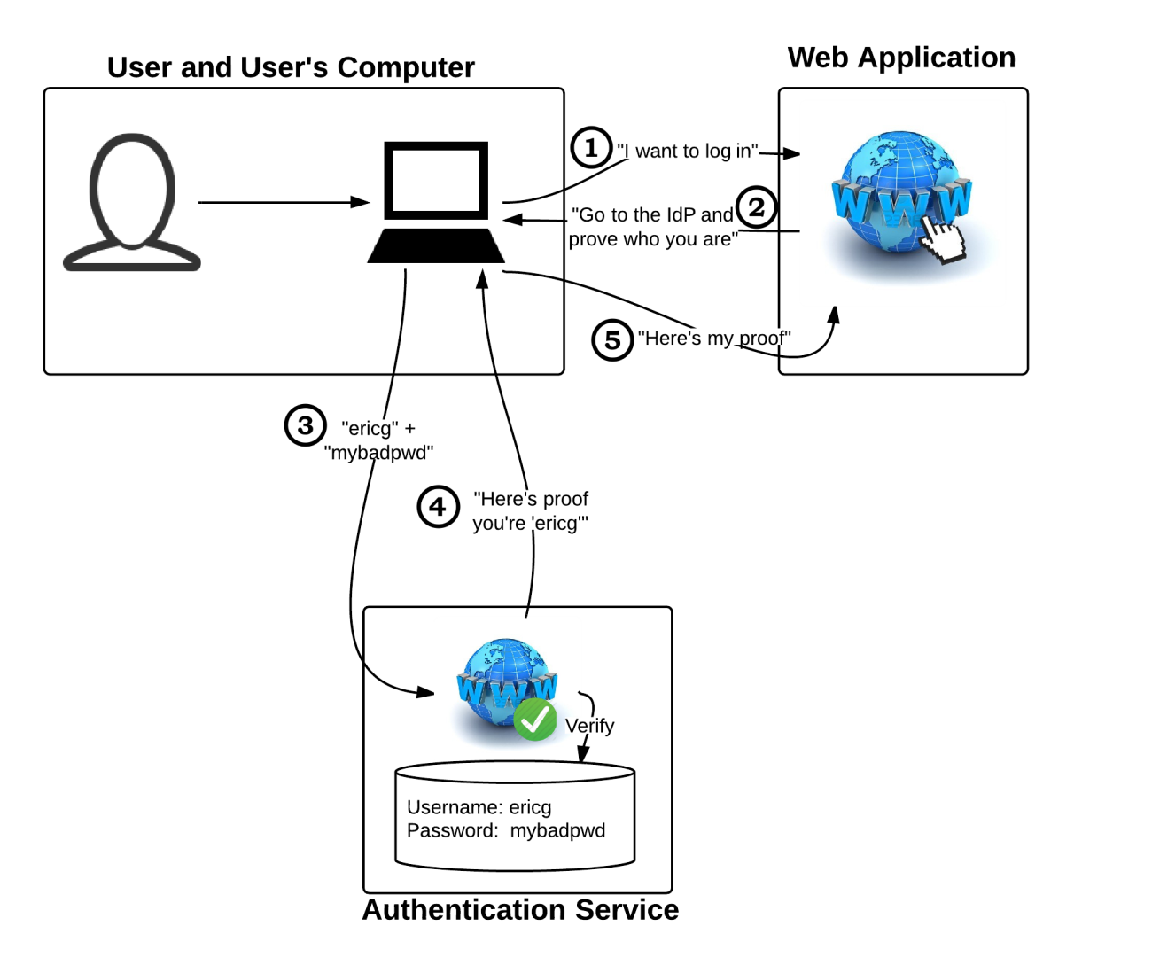
Federated Authentication

Slide 18
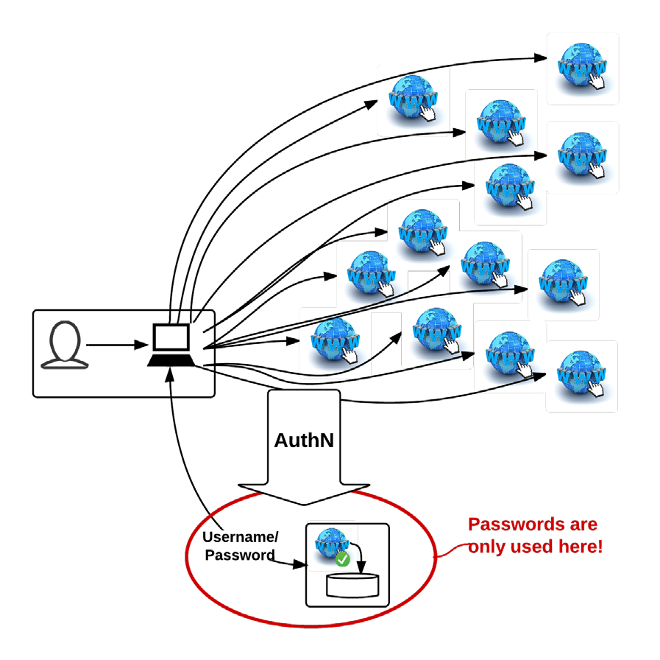
Federated Authentication - Scaling

Slide 19
Federated Authentication – Scaling
Pros
Security
Single application handles all passwords
Users always enter passwords on same website
Flexibility
Changes to authentication process can be handled centrally
Multi-factor, expired accounts
Provides better privacy hooks
Federation
Allows integration with multiple account stores/IdPs
Not limited to users from one campus
Cons
Largely Web-Only
Learning curve is somewhat steep
Vendor implementations are frequently flawed

Slide 20
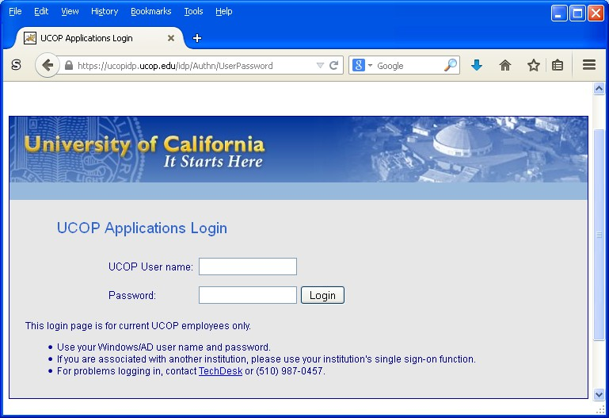
Common Login Page

Slide 21
For New Applications
Use Federated Authentication
More secure than other mechanisms
Especially important when working with vendors
Insist on SAML integration support
Avoid Pass Thru Authentication
In some circumstances (esp. non-web applications) Pass- Thru may be acceptable.
Less secure than SAML integration
Do not design around local accounts
Users are nearly guaranteed to reuse passwords
Adds account management burden locally
28

Slide 22
Preparing for IAM Integration
Separate code that performs Authentication
Write code expecting external (SAML) Authentication
Account != Permission
Rely on Roles or Attributes for access controls (RBAC/ABAC)
Roles and Attributes can be sourced externally

Slide 23
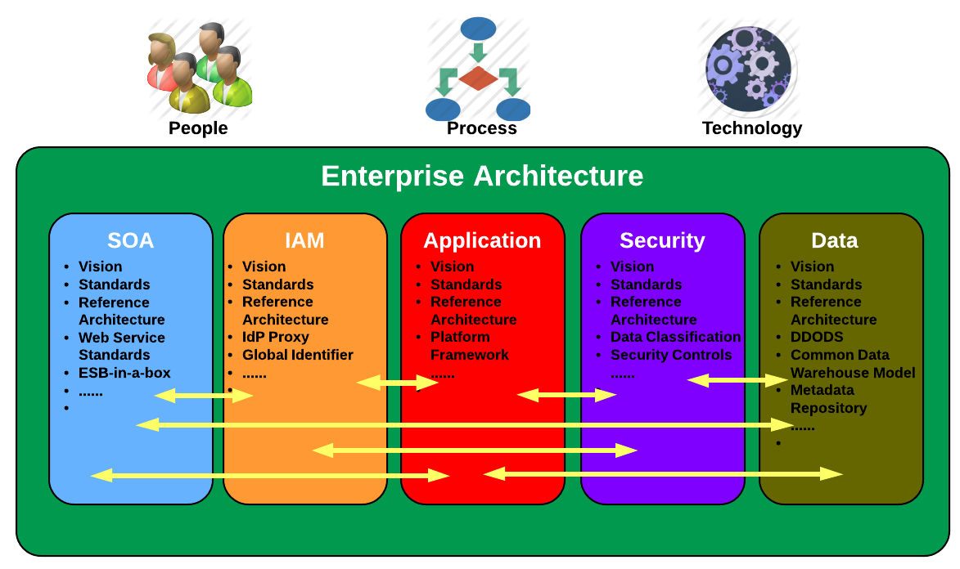
How Does IAM Apply to ITS?
IAM is an area of Enterprise Architecture (EA) focus
EA describes significant structural components such as information, process and technology assets and how they are used to support optimized business execution.
EA supports shared services, interoperability and IT<->business alignment
Notes:
Presenter
2014-10-13 09:52:37
--------------------------------------------
Want compatibility, interoperability, consistency, etc.

